Slide 1
Online Edu. Employment (Android)
Project Plan
VEL team
14 Aug. 2015

Slide 2
Project Plan
Agenda
1. Team VEL
2. Product Owner
3. Project Goal & Major Capability
4. Product Backlog
5. Development Plan
6. Scrum PM Tool
7. One User Story
8. Risk Management

Slide 3

1. Team VEL (1)
Team name & logo

Slide 4
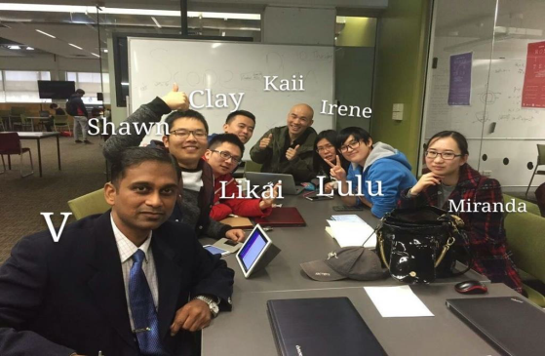
1. Team VEL (2)
Team members

Slide 5

2. Product Owner – CEO of GetSkills.co.nz
www.getskills.co.nz
CEO have some concerns about their website
About Them:
New Zealand based IT training company
Objective: Teach, Train and Place
Placement is Commitment

Slide 6
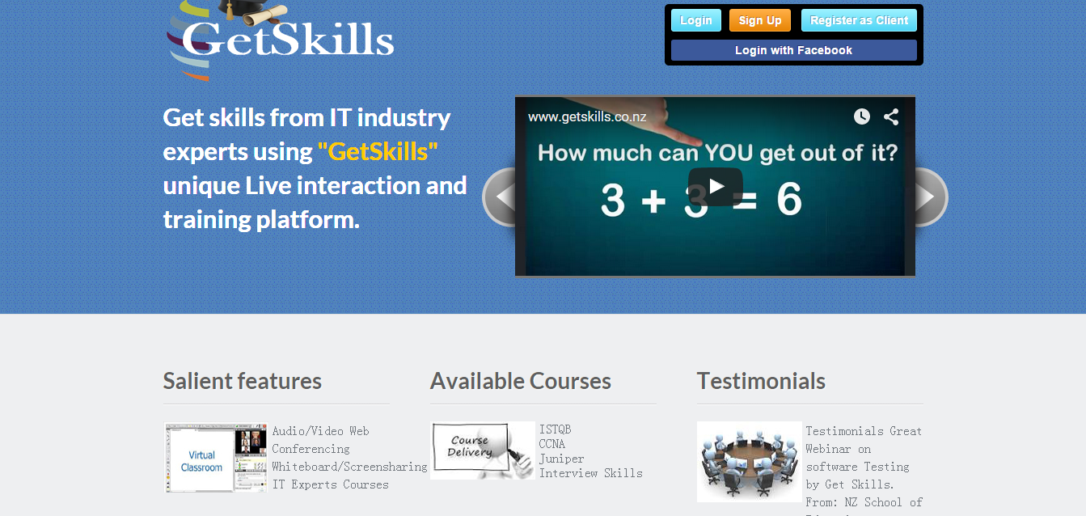
3. Project Goal and Major Capability
getskills.co.nz/

Slide 7
3. Project Goal and Major Capability
Major Capabilities:
1) Visitor ----- view the website, scan the course list, take a test without registering
2) System (course advisor) ---- give the user a short survey, give a list of successful examples, recommend some suitable courses
3) User ---- select courses, make payments online, take courses via video or audio

Slide 8
4. Product Backlog
S.No. | Priority Level | Product Backlog
1 | 1 | Getskills website should adapt the size of the browser automatically with respect to the device in which the website is seen. For e.g. if the website is seen then the mobile phone, then the browser should change its size according to mobile phone screen, and display its contents properly. If the website is viewed from a Tablet / Laptop then the browser should change its size automatically in such a way that it displays content properly in the tablet/Laptop respectively.
2 | 2 | As a visitor to "GetSkills" website, the visitor can select a test and make payments to the selected tests, without registering in the Getskills website.
3 | 2 | Visitors of Getskills website is categorised based on the survey. Based on the category, Successful stories of alumni's associated with Getskills is published. On viewing the Successful stories of Alumni, the visitor is prompted to take a similar course / test that is available in Getskills.
4 | 3 | An exclusive webpage is allotted to promote Getskills Automation Tool, with Successful stories of automation tool implemented companies.

Slide 9
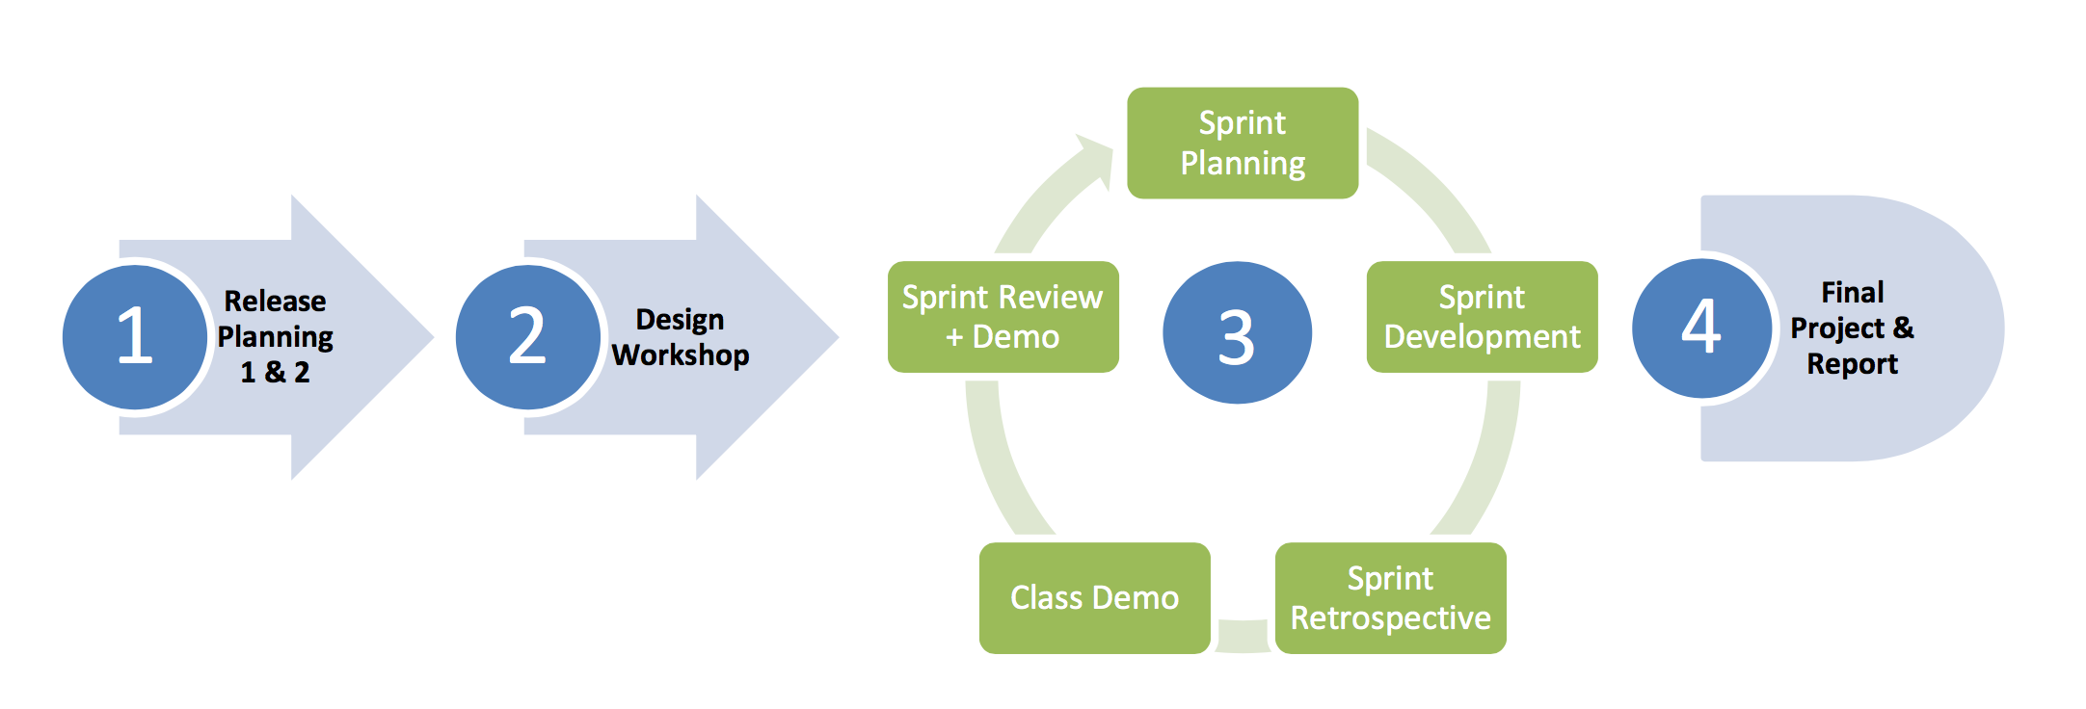
5. Development Plan (1)

Slide 10
5. Development Plan (2)
Design Workshop
Mock up system with minimum functionality and show case of adaption to different size of device will be developed.
Fully customised to adapt desktop/laptop, tablet and mobile phone.
Deliverable consist of a demo system with mock

Slide 11
5. Development Plan (3)
Sprint 1
Core function including main page, course list and course detail, dynamic menu, course category.
Each page will be applied by size adaption framework
Server interaction will be concurrently developed in this sprint.
Deliverable minimum fully functional online course web site, with well tuned adaption to each screen size device

Slide 12
5. Development Plan (4)
Sprint 2
Visitor customised content focus on functionality on recognition of visitor’s personal background, and generate customised content for each type of visitor, display successfully stories and corresponding courses which leads to high possibility of commit deals.
Deliverable consist of visitor recognition functionality, dynamic content, successful stories and corresponding courses.

Slide 13
5. Development Plan (5)
Sprint 3
On-line help desk, shopping cart, and other potential customer requirements. According to the customer, these functionalities need further discussion.
Refinement of product backlog will be done along while project on-going.
Deliverable to be decided.

Slide 14
5. Development Plan (6)
Software Testing
Test scenarios will be designed and test cases will be executed within each sprint.
Including unit testing, integration testing, system testing and customer acceptance tests.
Deliverable consist of test reports.

Slide 15
5. Development Plan (7)
Defect Management
Defect management tool will be used on demands. Defects will be labelled with 3 levels of severity:
Critical – system clash, module level failure, infrastructure failure, etc.
Major – functional misbehaviour, missing functionality, etc.
Minor – layout issue, user friendly issue, issues with work around, etc.

Slide 16
5. Development Plan (8)
Software Release
System will be bundled as deployable
Design documents
Test reports
Installation guide
User guide

Slide 17
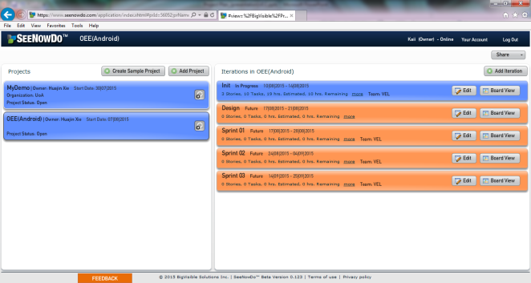
6. Scrum PM Tool (1)
SeeNowDo
URL: https://www.seenowdo.com/pages/login/index.html
Project Name: OEE(Android)
Image of project list & iteration list

Slide 18
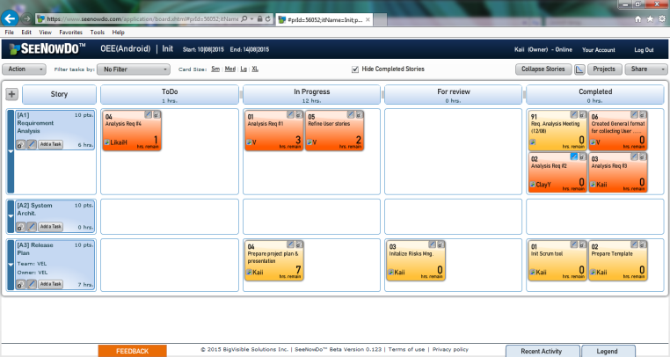
6. Scrum PM Tool (2)
SeeNowDo
Image of User Stories and Tasks List of one sprint

Slide 19
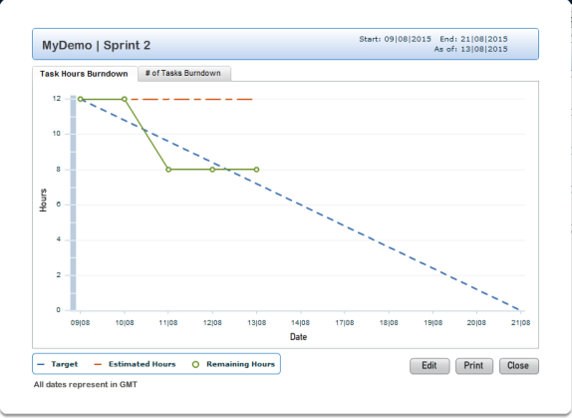
6. Scrum PM Tool (3)
SeeNowDo
Image of Burn-Down Chart

Slide 20
7. One User Story (1)
User story #1
As visitor, when I use mobile devices (phones and pads) to access the website, I want to see that the framework (the header, footer and buttons) of this website is suitable for my using behavior on mobile devices
So that I can use this website on mobile devices as convenient as on PCs.

Slide 21
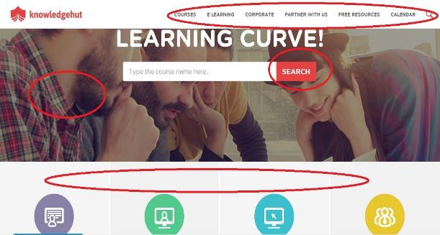
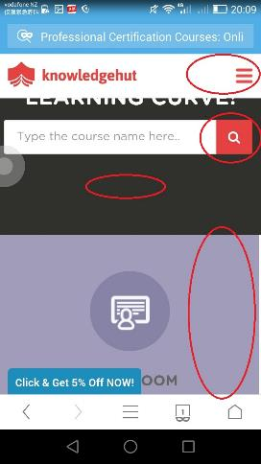
7. One User Story (2)
The menu, button, picture and layout may change from PC to phones.

Slide 22
7. One User Story (3)
User story #1
As visitor, when I use mobile devices (phones and pads) to access the website, I want to see that the framework (the header, footer and buttons) of this website is suitable for my using behavior on mobile devices
So that I can use this website on mobile devices as convenient as on PCs.
Device type detection
DPI & resolution detection
Dynamically changing style

Slide 23
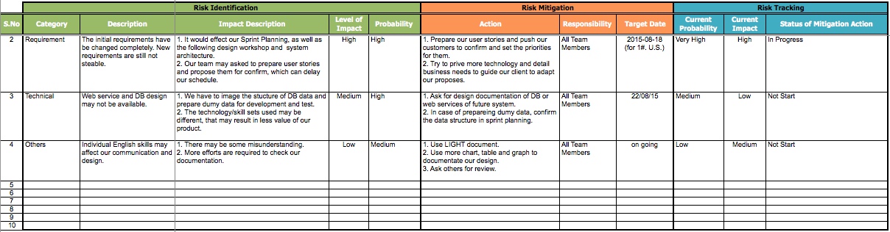
8. Risk Management
The Risk Tracking will be carried out after daily scrum. You can find the documentation in our GitHub, located /PCB/02 Plans & Actuals/2.3_Risk & Issue.

